Slide 1
Learnings in Shopify
Shabana Rumane

Slide 2
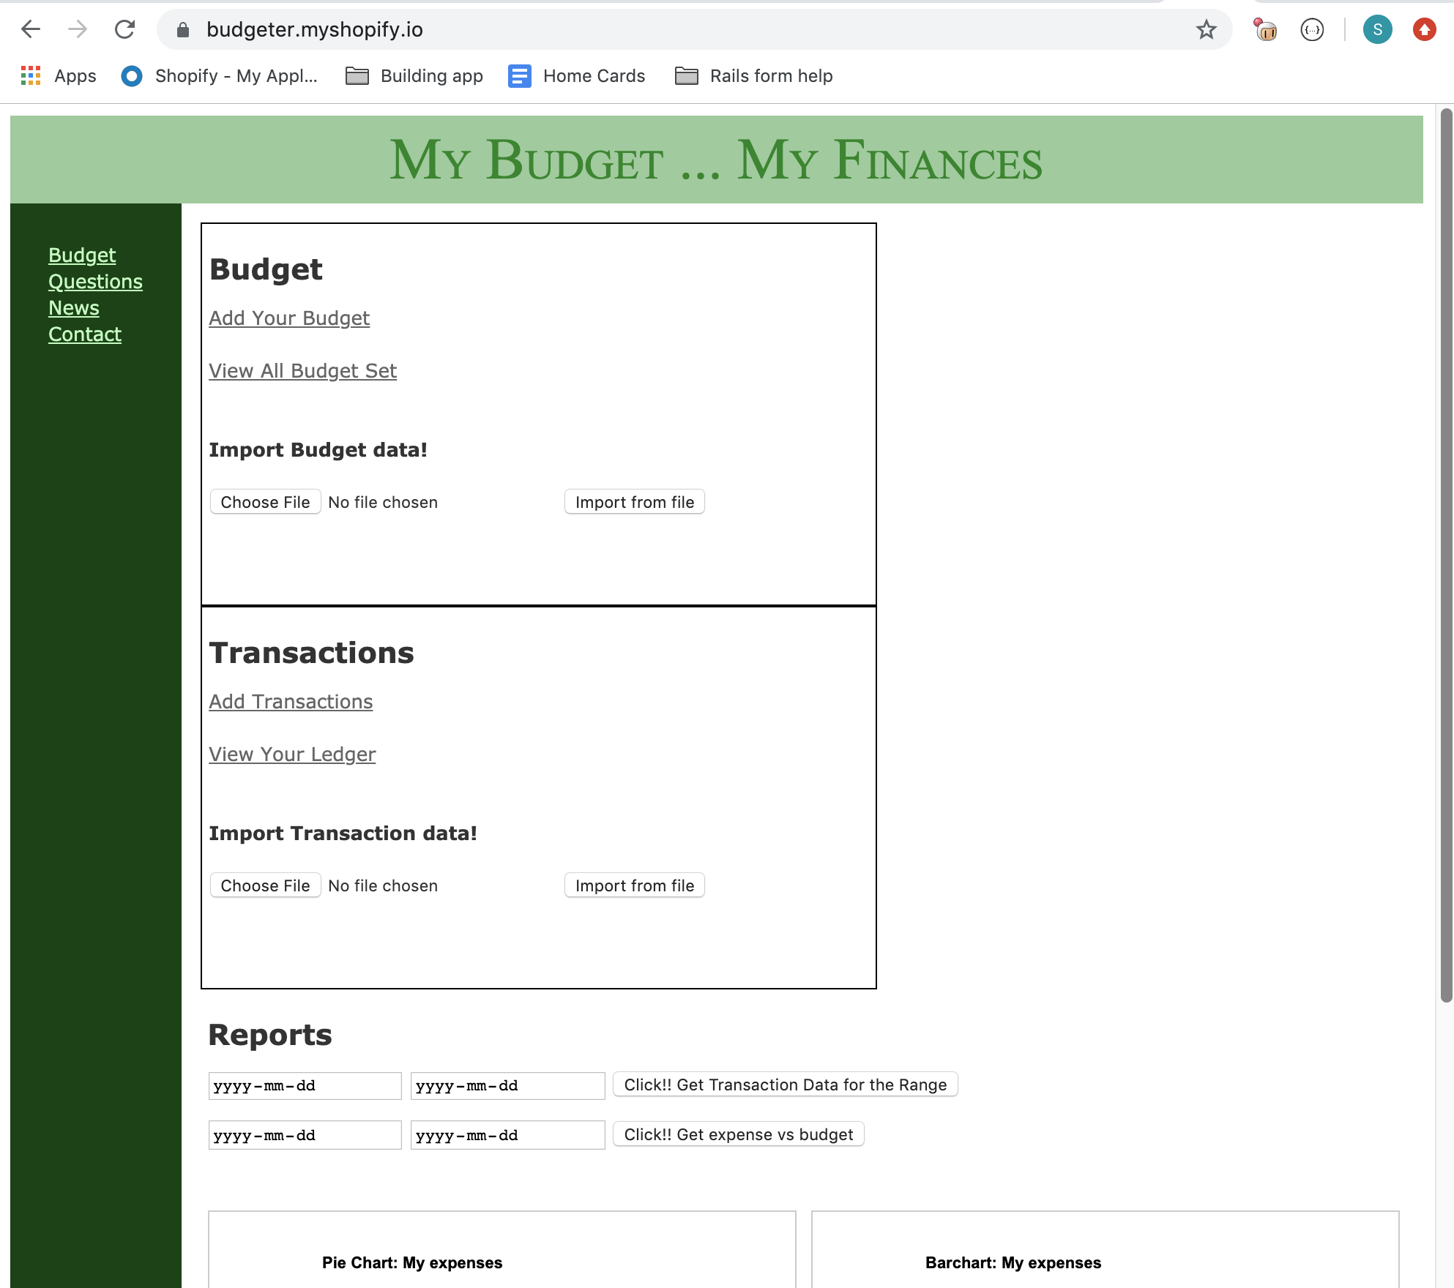
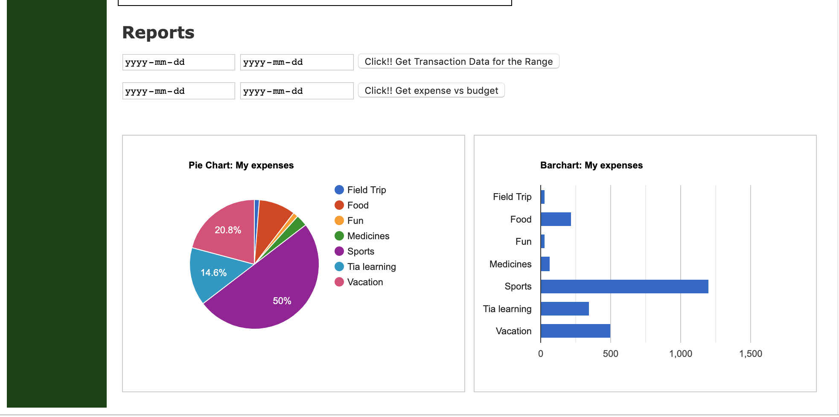
Rails - Budgeter

Slide 3
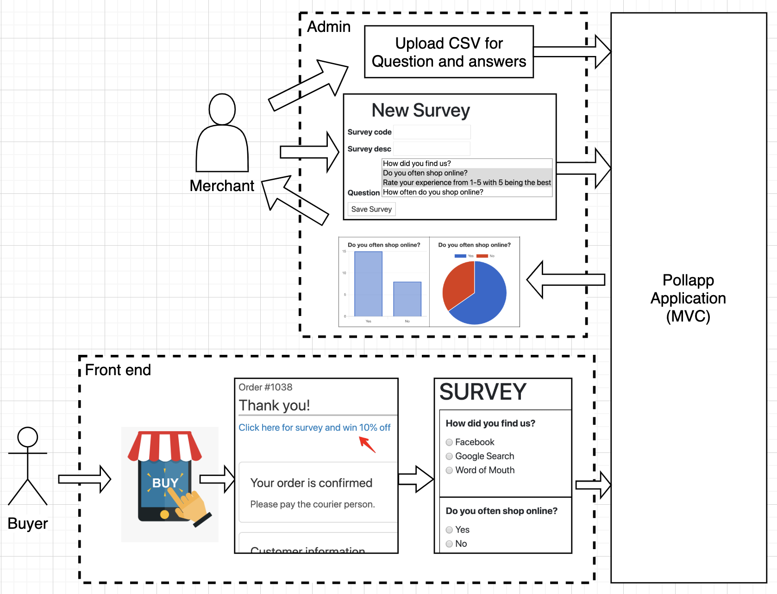
Shopify App - Pollapp
Business Flow

Slide 4
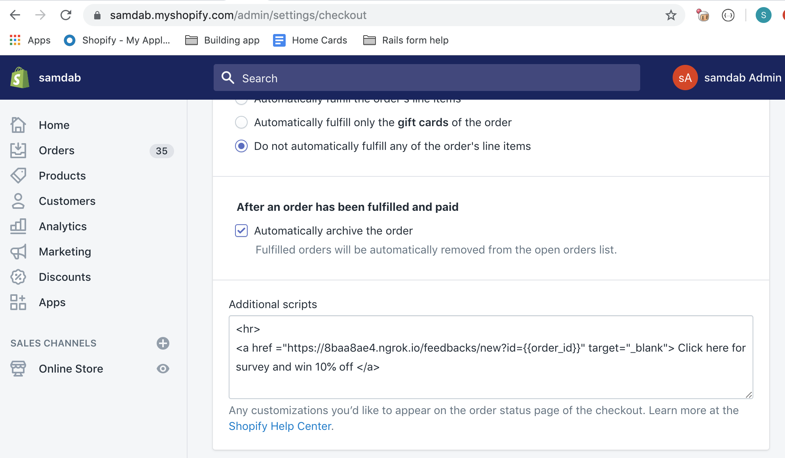
Admin page -> settings -> Checkout

Slide 5
Architecture
Diagram
Buyer’s View
Merchant’s View
Controller
Model
Survey form
Survey controller
Survey Model
Feedback form
Feedback controller
Feedback Model
Charts and graphs
Home controller

Slide 6
Pollapp - data model
1
Answer Category
1
n
n
Questions
Answer Options
1
1
Feedback
n
n
Survey
n
1

Slide 7
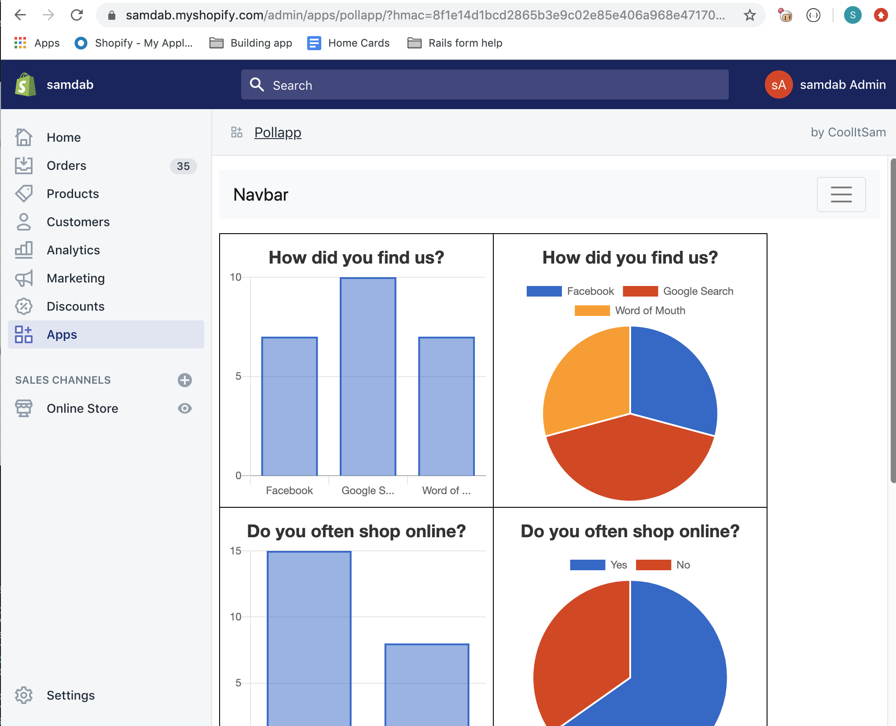
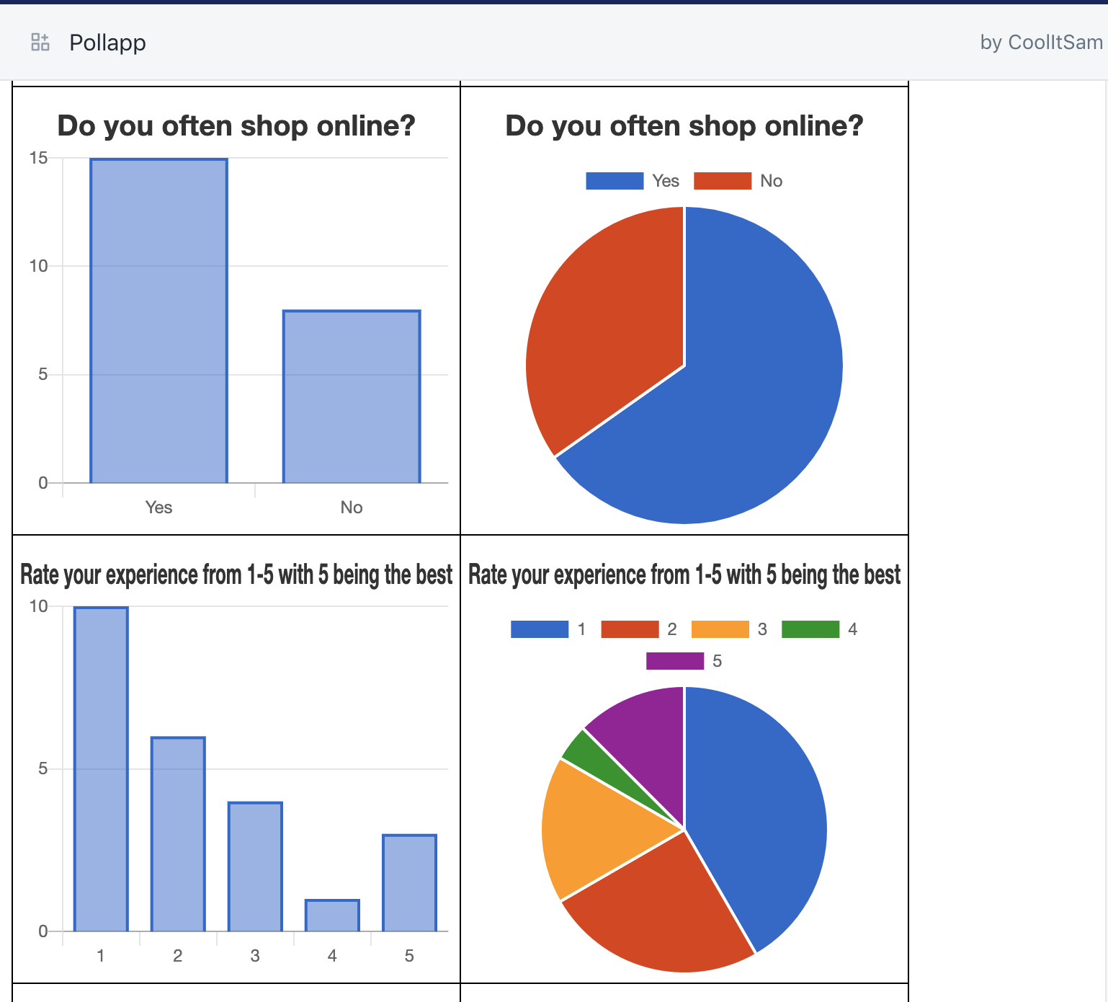
Shopify app - Poll/Survey app

Slide 8
Limitations:
All buyers get the same survey. Data model support multiple surveys, but currently not implemented.
The buyer has the freedom to submit empty survey - nothing will be saved to the database
Out of Scope:
Form to enter questions/answers instead of csv
Application of 10% rebate on next buy. Also, ability to not show the link if the customer has already availed the 10%

Slide 9
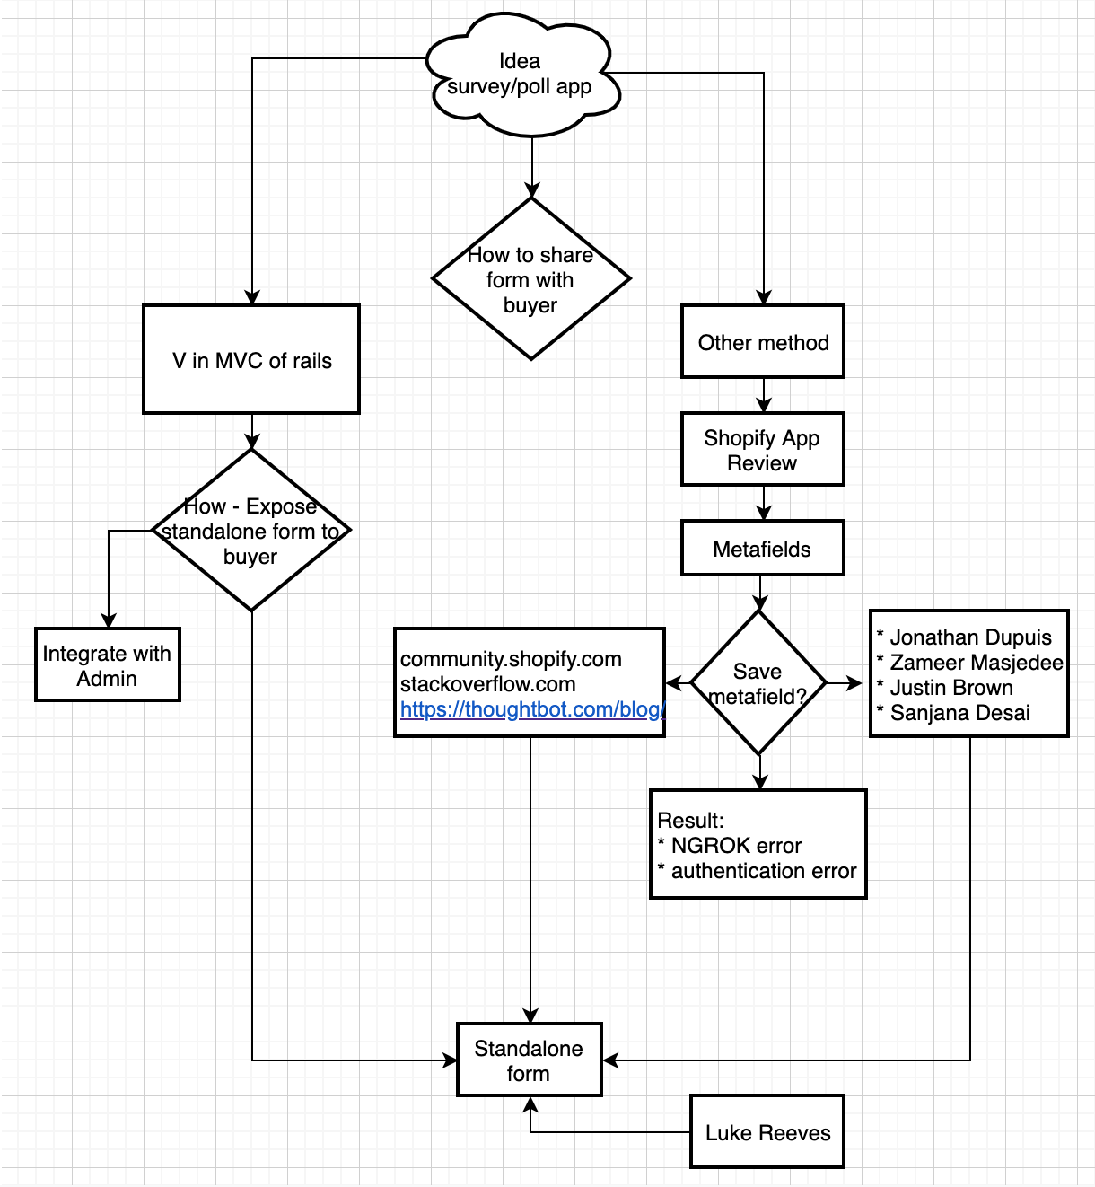
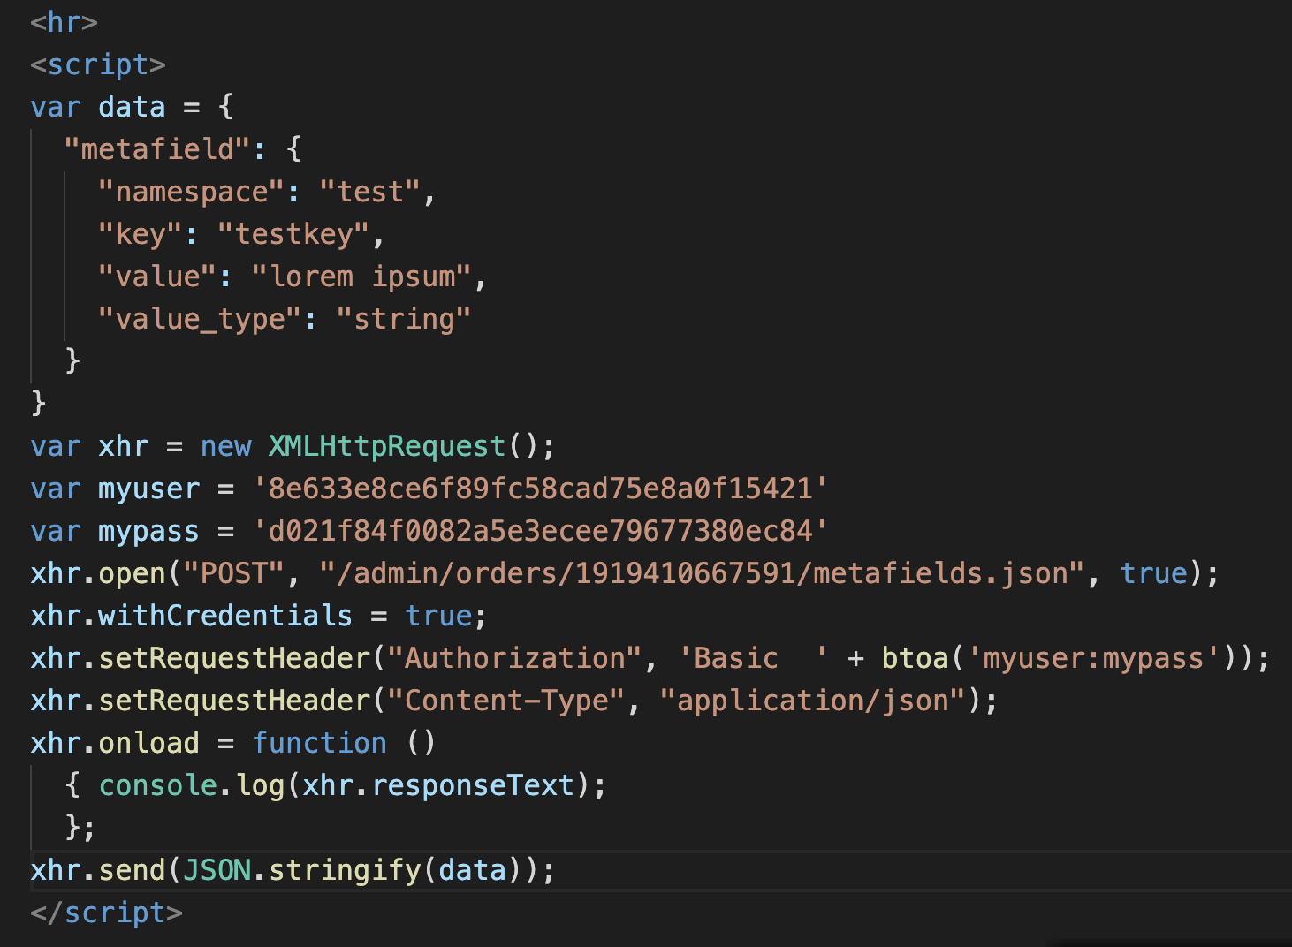
My struggle with Metafields

Slide 10
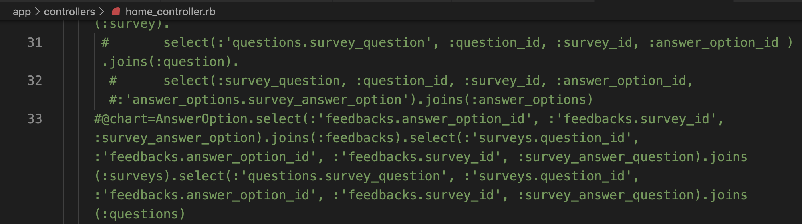
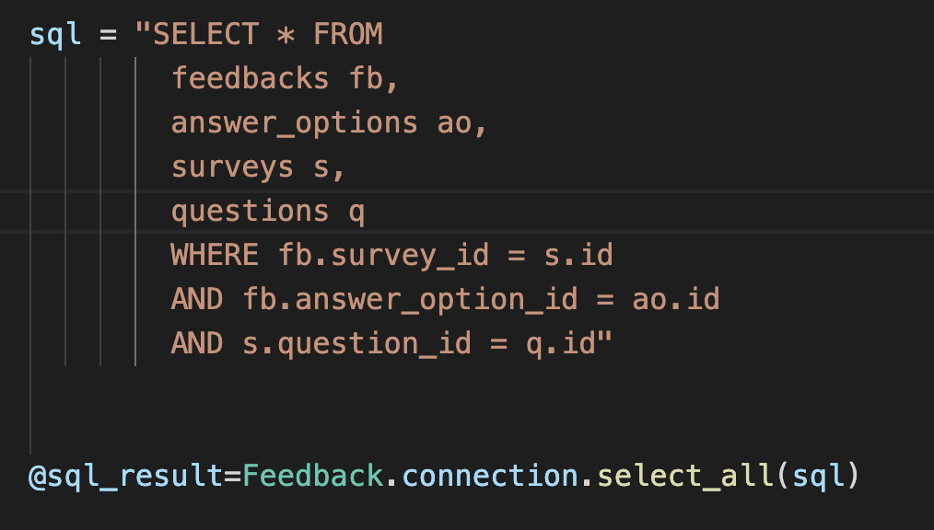
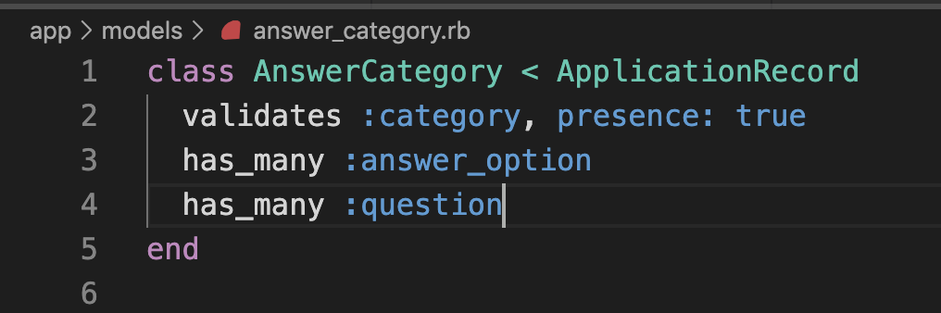
Native SQL vs Rails joins helper method
Does
Not
work
Work
around
Possible bug

Slide 11
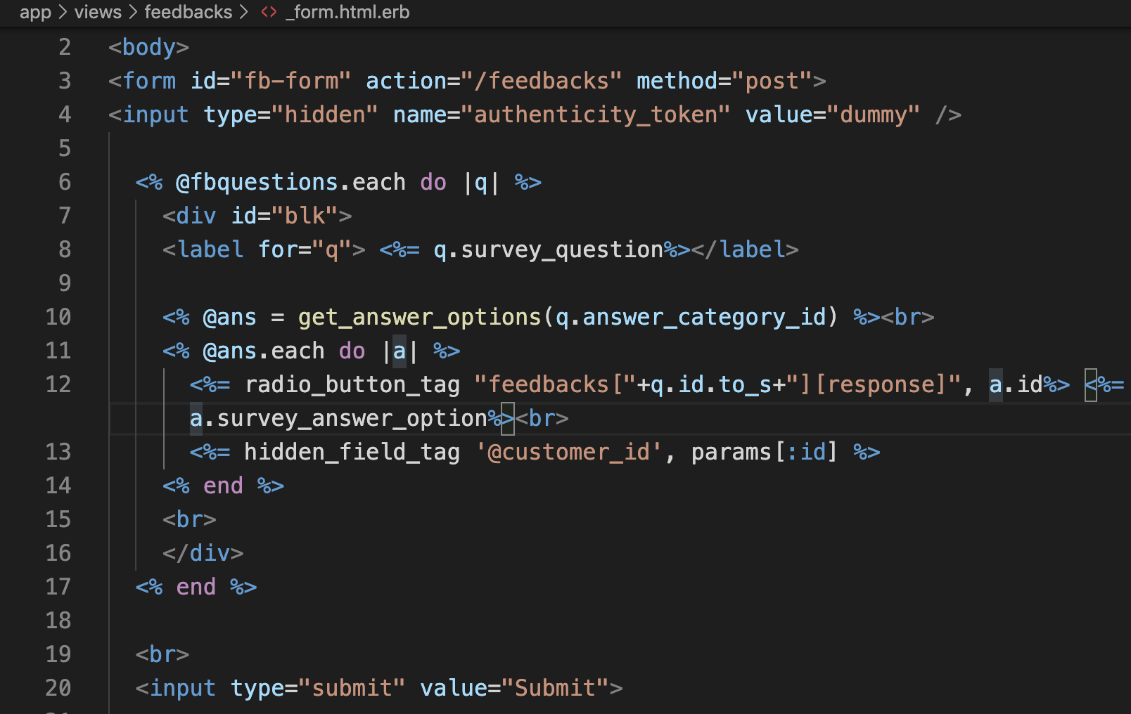
Issues with the form
Selection of radio button
Rails method form_with vs native html

Slide 12
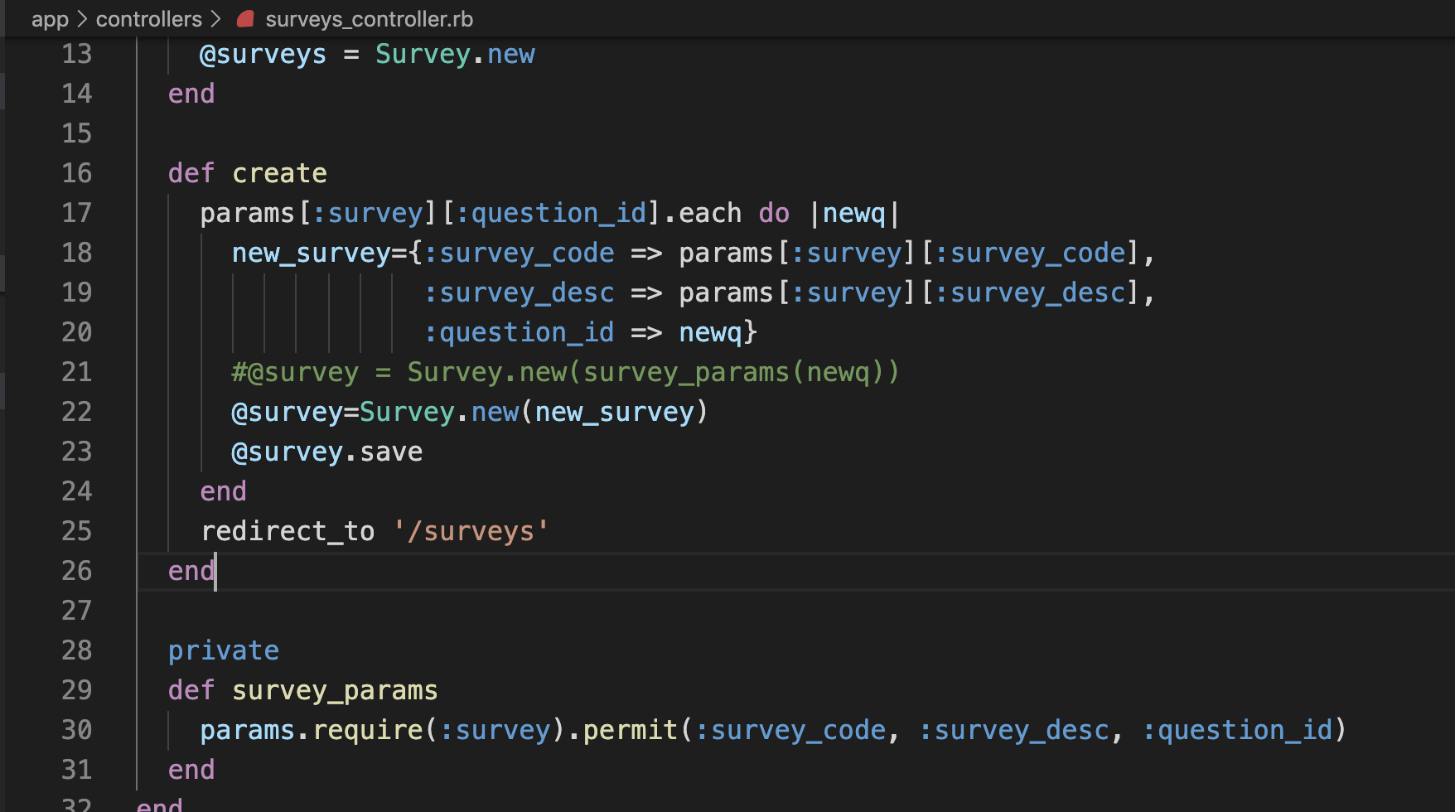
Require/permit
Had to bypass require/permit
Possible to use require/permit for arrrays

Slide 13
Acknowledgements/Resources
Kyle Acres Jackson Hong Luke Reeves Mehul Shah Caroline Rioux Justin Brown Zameer Masjedee Ben Graham | guide.rubyonrails.com Stackoverflow.com Apidock.com Rubyinrails.com Developers.google.com Blog.arkency.com Sitepoint.com help.shopify.com/en/themes/liquid/basics help.shopify.com/en/manual/products/metafields

